Slide 1
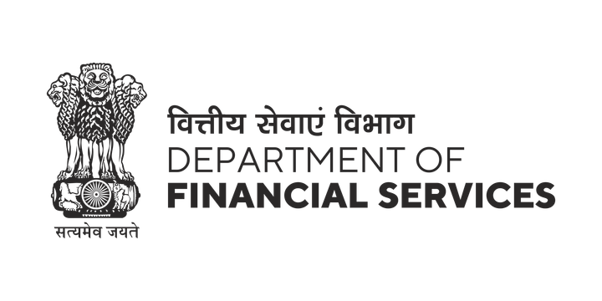




PSBs Hackathon Series 2026
(An Initiative of Government of India, Ministry of Finance , Department of Financial Services)
PRESENTS

Slide 2

PROBLEM STATEMENT & TEAM DETAILS
TEAM NAME (AS SUBMITTED ON PORTAL) |  | syntax_error
PROBLEM STATEMENT TITLE |  | PS3- Tracking of Funds within Bank for Fraud Detection
 | NAME | GENDER | AREA OF EXPERTISE
Member 1 | Vaideeka Agrawal | Female | Full Stack, Machine Learning, AI
Member 2 | Vedansh Kapoor | Male | Machine Learning, Computer Vision, Gen AI, Data Science
Member 3 | Adarsh Panjwani | Male | Machine Learning, Image Processing, Data Science, AI
Member 4 | Shourya Pawan Kalbande | Male | Machine Learning, Data Science, AI

Slide 3
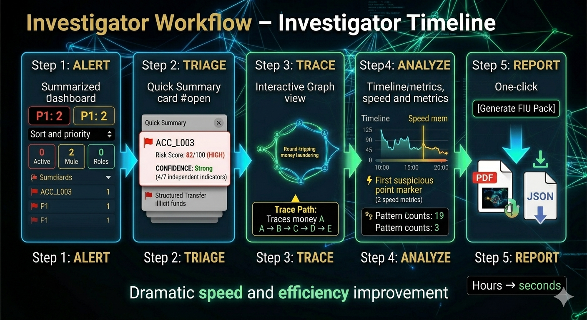
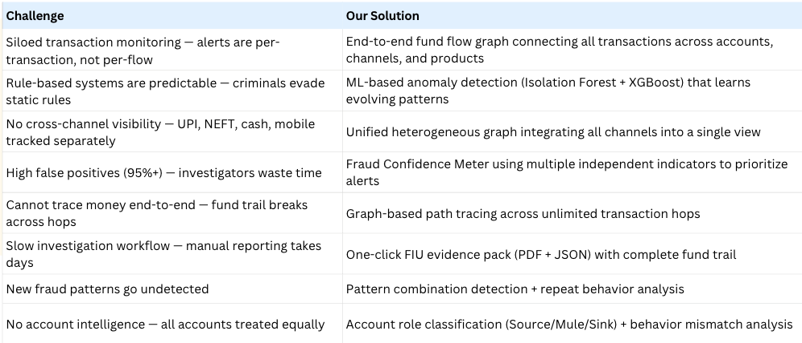
IDEA TITLE
Solution (Describe your Idea / Solution / Prototype)
How It Works:
How TraceX Solves Key Problems
Pipeline:
1. Data Ingestion → Transactions + account metadata
2. Graph Construction → Accounts (nodes), transactions (edges)
3. Feature Engineering → Graph + behavioral + profile features
4. Multi-Layer Detection → ML (Isolation Forest, XGBoost) + rules + graph analytics
5. Risk Intelligence → Risk score + confidence + priority + role classification
6. Investigator Interface → Graph explorer, summaries, pattern detection
7. Evidence Generation → One-click STR pack (PDF + JSON + graph)

Slide 4
DEMO DETAILS
Beyond Traditional AML Systems
Moves from transaction-based monitoring to a full graph-based fund flow model
Replaces static rules with an ensemble approach combining ML, graph analytics, and pattern detection
Transforms alerts into explainable insights with confidence levels and feature importance
Converts raw data into complete account intelligence (Role, Risk, Confidence, Priority, History)
Reinventing Investigation Experience
From static dashboards → interactive graph exploration
From fragmented alerts → end-to-end fund flow tracing
From manual reporting → one-click FIU-compliant evidence generation
From partial visibility → unified cross-channel intelligence
Advanced Fraud Understanding
Detects 6+ fraud typologies with pattern combinations
Identifies first suspicious transaction (fraud origin)
Tracks fund velocity and rapid movement patterns
Enables real behavioral analysis instead of rule triggers
Our Unique Innovations
Fraud Confidence Meter for reducing false positives
First Suspicious Point Detection to identify origin of fraud
Account Role Classification (Source / Mule / Sink)
Pattern Combination Detection for complex fraud scenarios
One-Click Evidence Pack (FIU-ready in seconds)

Slide 5
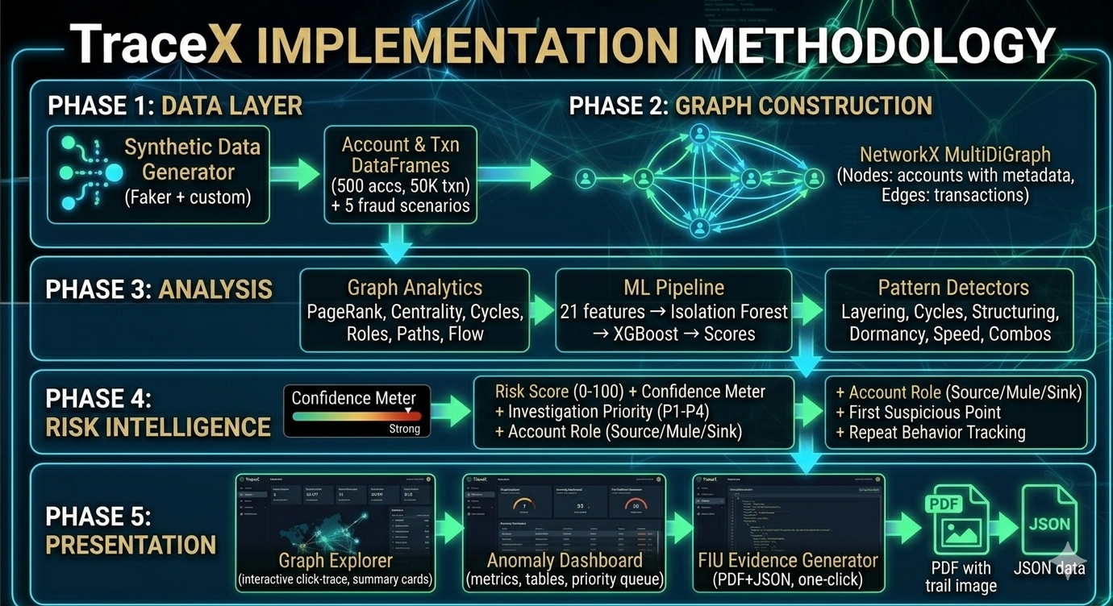
TECHNICAL APPROACH
Technologies to be used : Methodology and process for implementation:
Graph: NetworkX
ML: Isolation Forest, XGBoost
Data: pandas, numpy
Full Stack: Streamlit/Next.js
Visualization: PyVis, Plotly
Reports: PDF + JSON
Language: Python

Slide 6
FEASIBILITY & VIABILITY
Feasibility Assessment
Technical: Proven stack (NetworkX, XGBoost, Streamlit) → fast, scalable, real-time capable
Data: Synthetic Indian banking data + labeled fraud scenarios enable reliable demo & training
Time (24 hrs): Parallel development (4 devs) → all core features achievable
Cost: 100% open-source → zero licensing, runs on local systems
Regulatory: Aligned with FIU-IND, PMLA Sec 12, RBI AML/KYC norms
Scalability: Designed for NetworkX → Neo4j migration (handles millions of accounts in production)
Key Risks
Graph rendering slows with large datasets
ML models may overfit synthetic data
Cycle detection computationally expensive
Real bank data is noisy & inconsistent
False positives still possible
Integration with legacy CBS systems
Data privacy & DPDP compliance challenges
Mitigation Strategies
Performance: Progressive graph rendering + suspicious-only view
Model Robustness: Isolation Forest (unsupervised) + retraining on real data
Efficiency: Limit cycle depth + pre-filter high-risk nodes
Data Quality: Strong ingestion layer (validation, null handling)
False Positives: Confidence Meter + priority-based alert filtering
Integration: API-based modular architecture (FastAPI, standard formats)
Privacy: Federated design + hashed IDs, no raw PII exposure

Slide 7
BUSINESS MODEL
Revenue Model (B2B SaaS + Licensing)
SaaS Subscription: ₹50L–₹2Cr/year per bank (cloud-hosted platform)
On-Premise License: ₹1Cr–₹5Cr + AMC for data-sovereign banks
Implementation & Integration: ₹25L–₹75L (CBS + custom rules)
Training & Support: ₹10L–₹25L/year
FIU Report-as-a-Service: ₹500–₹2000 per evidence pack
Target Customers
Primary: Public Sector Banks (high compliance burden, regulatory pressure)
High Potential: Private Banks, Fintechs (digital fraud risk, tech adoption)
Growing Segments: NBFCs, Cooperative Banks under increasing AML scrutiny
Value Proposition
TraceX transforms AML from manual, high-false-positive systems into a graph-powered, explainable intelligence platform
→ 3× fewer false positives
→ 10× faster investigations
→ One-click FIU-compliant evidence generation
→ End-to-end fund flow visibility with actionable insights
Market Opportunity & Growth
India AML Market: ~₹2,500 Cr (18% CAGR)
Global Market: $4.2B → $8.1B (by 2029)
Beachhead: PSBs + top private banks (~₹400–600 Cr)
Roadmap:
Pilot (0–6m) → PSB Expansion (6–18m) → Private Banks/NBFCs (18–36m) → Global (36m+)
Go-to-Market Strategy
Free 3-month PSB pilot → prove ROI
Integrate with CBS (Finacle, Flexcube, BaNCS) via partners (TCS, Infosys)
Ensure FIU/RBI compliance + SOC2/ISO security
Deploy on India-compliant cloud / on-premise
Key Challenges & Strategy
Slow bank procurement: Pilot-led conversion
Legacy integration: Modular APIs + services
Strong competition: Differentiate via graph-first + explainability + lower cost

Slide 8
IMPACT & BENEFITS
Social Impact
Identifies and protects mule account holders exploited by fraud networks
Strengthens detection of terror financing and illegal money flows
Improves public trust in banking systems, especially PSBs
Reduces workload on law enforcement agencies through ready evidence
Regulatory & Operational Benefits
Ensures compliance with PMLA, RBI AML/KYC norms, FATF standards, and DPDP Act
Provides real-time, end-to-end fund visibility across UPI, NEFT, RTGS, cash, ATM
Builds institutional intelligence by capturing fraud patterns systematically
Designed for scalability (NetworkX → Neo4j)
Impact on Target Audience
AML Investigators: Manual tracing (18–45 days) → click-to-trace in minutes; 3× fewer alerts with higher true positives and instant evidence generation
Chief Compliance Officers: Audit-ready AML with automated, FIU-compliant STR reports → reduced regulatory risk and penalties
Branch Managers: Real-time visibility into suspicious activity via branch-level and channel analytics
FIU-IND: Standardized, complete STR submissions with full fund trails, reducing back-and-forth queries
Law Enforcement (ED/CBI): Court-ready evidence packs with visual graphs and transaction trails for faster prosecution
Economic Benefits
10× investigator productivity → same team handles significantly more cases
Up to ₹10 Cr/year savings by avoiding regulatory penalties
15–25% higher fraud detection → direct financial loss prevention
Reduced hiring needs → saves ₹50L–1Cr annually
STR generation time: days of manual work → seconds

Slide 9
LINK TO ALL DELIVERABLES
D1- Problem + Solution Brief: https://docs.google.com/document/d/1zA_kxNb4IB3dh24WB1JCLibrMLoYtO4TodRa3U2oi7I/edit?usp=sharing
D2- Deployed / Live URL: https://youtu.be/0luXt9s5efI
D2- Frontend-Backend Demonstration Video (YouTube):
D3- Technical Architecture Document: https://docs.google.com/document/d/1KwYOjYVl6_WBN3uyjc3WaM276vzI3bTbpiEsQZ-IZuU/edit?usp=sharingD4- GitHub Repository: https://github.com/VaideekaAgrawal/TraceX-FinTech
D5- Pitch Deck:
D5- Pitch Video (YouTube): https://youtu.be/0luXt9s5efI

